Slide 1




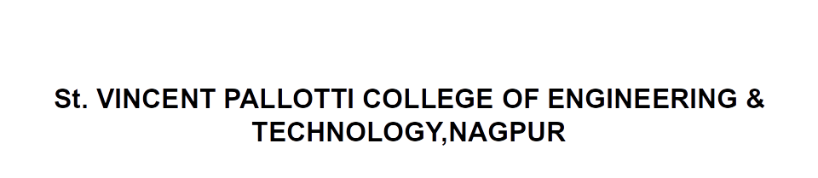
Open Elective –III Transportation System
CV705T

Slide 2

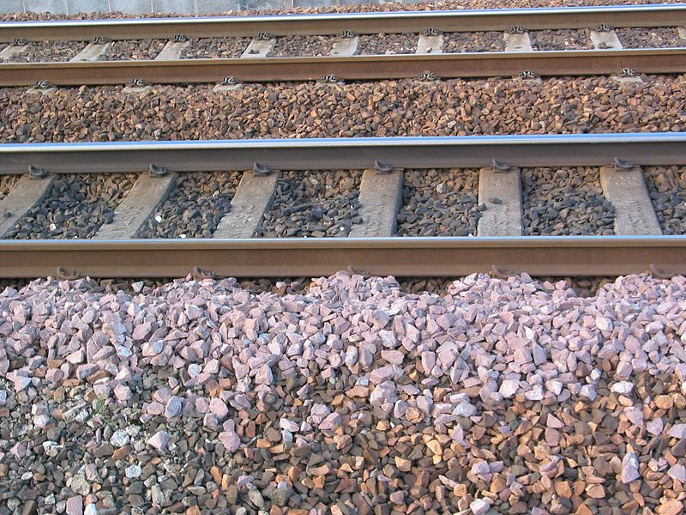
Ballast
It is a layer of broken stones, gravel or any other such gritty material laid and packed below and around sleepers.
Functions of ballast:
To distribute the loads uniformly over the subgrade.
To provide good drainage for the track structure.
To provide elasticity and resilience to track for getting proper riding comfort.
To held the track structure to line and grade.
To reduce dust.
To prevent growth of brush and weeds.

Slide 3
A good ballast should be strong, hard-wearing, stable, drainable, easy to clean, workable, resistant to deformation, easily available, and reasonably cheap to purchase.
Early railway engineers did not understand the importance of quality track ballast; they would use cheap and easily-available materials such as ashes, chalk, clay, earth, and even cinders from locomotive fireboxes.
It was soon clear that good-quality ballast made of rock was necessary if there was to be a good foundation and adequate drainage.

Slide 4
Requirements of Good Ballast:
1.It should be tough and should not crumble under heavy loads.
2.It should not make the track dusty or muddy.
3.It should offer resistance to abrasion and weathering.
4.It should not produce any chemical reaction with rails and sleepers.
5.The materials should be easily workable.
6.It should retain its position and should not be distributed.

Slide 5
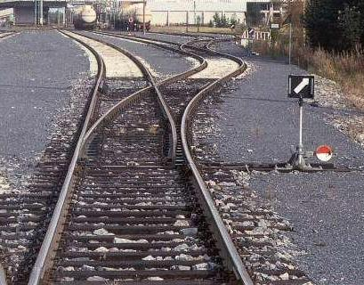
Railroad switch
A railroad switch, turnout or [set of] points is a mechanical installation enabling railway trains to be guided from one track to another, such as at a railway junction or where a spur or siding branches off.

Slide 6
A switch generally has a straight "through" track (such as the main-line) and a diverging route. The handedness of the installation is described by the side that the diverging track leaves.
Right-hand switches have a diverging path to the right of the straight track, when coming from the narrow end and a left-handed switch has the diverging track leaving to the opposite side.

Slide 7
A straight track is not always present.
For example, both tracks may curve, one to the left and one to the right (such as for a wye switch) or both tracks may curve, with differing radii, in the same direction.

Slide 8
Rail Gauge
Track gauge or rail gauge is the distance between the inner sides of the heads of the two load bearing rails that make up a single railway line.
Sixty percent of the world's railways use a standard gauge of 1,435 mm (4 ft 8½ in).
Wider gauges are called broad gauge; smaller gauges, narrow gauge.

Slide 9
Break-of-gauge refers to the meeting of different gauges.
Some stretches of track are dual gauge, with three or four rails, allowing trains of different gauges to share them.
An exception of a railway with no gauge is monorail where there is only one supporting rail.

Slide 10
Gauge tolerances specify how much the actual gauge may vary from the nominal gauge.
For example, the U.S. Federal Railroad Administration specifies that the actual gauge of track that is rated for a maximum of 60 mph (96.6 km/h) must be between 4 ft 8 in (1,422 mm) and 4 ft 9½ inch

Slide 11
Types of Gauges
The standard gauge (also named the Stephenson gauge after George Stephenson, or normal gauge) is a widely-used track gauge.
Approximately 60% of the world's existing railway lines are built to this gauge.
Except for Russia and Finland, all high-speed lines have been built to this gauge.
The distance between the inside edges of the rails of standard gauge track is usually called 1,435 mm but in the United States it is still called 4 ft 8½ in.

Slide 12
Broad gauge
Broad gauge refers to any gauge wider than standard gauge or 1,435 mm (4 ft 8 1⁄2 in).
Russian, Indian, Irish, and Iberian gauges are all broad gauges. Broad gauge railways are also common for cranes in docks for short distances.
Broad gauge is used to provide better stability or to prevent the easy transfer of rolling stock from railroads of other countries for political or military reasons.

Slide 13
Narrow Gauge
In many areas narrow gauge railways have been built.
As the gauge of a railway is reduced the costs of construction can also be reduced since narrow gauges allow a smaller radius curves allowing obstacles to be avoided rather than having to be built over or through (valleys and hills); the reduced cost is particularly noticeable in mountainous regions.

Slide 14
The most widely used narrow gauges are
1,067 mm (3 ft 6 in) Cape gauge
1,000 mm (3 ft 3 3⁄8 in) meter gauge)
762 mm (2 ft 6 in)

Slide 15


